Slide 1

Creating a Service

Slide 2
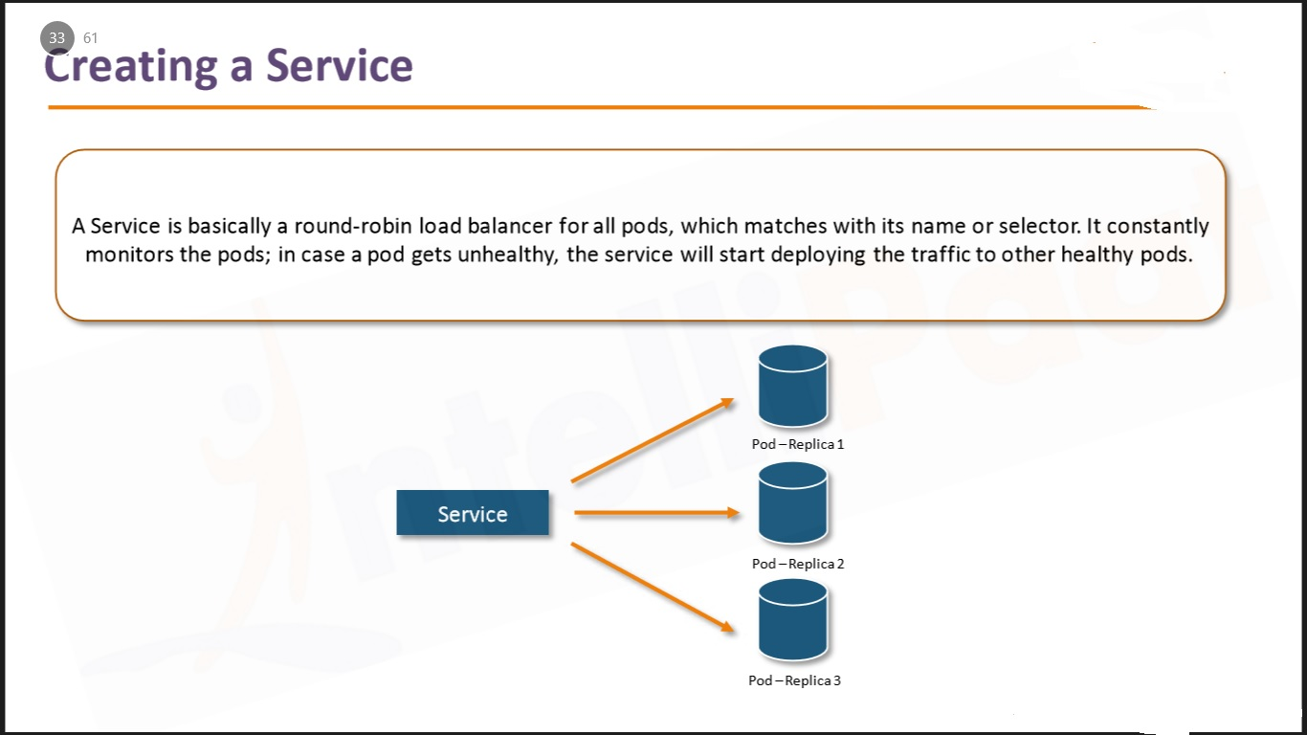

Slide 3
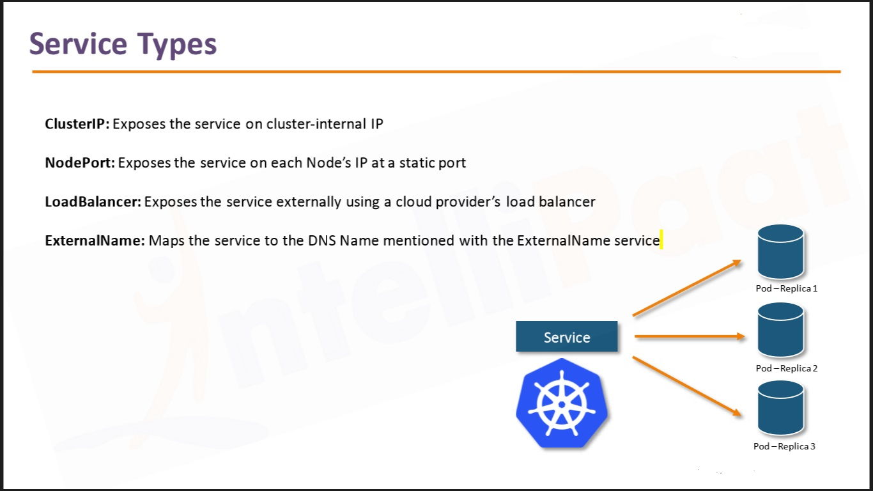

Slide 4
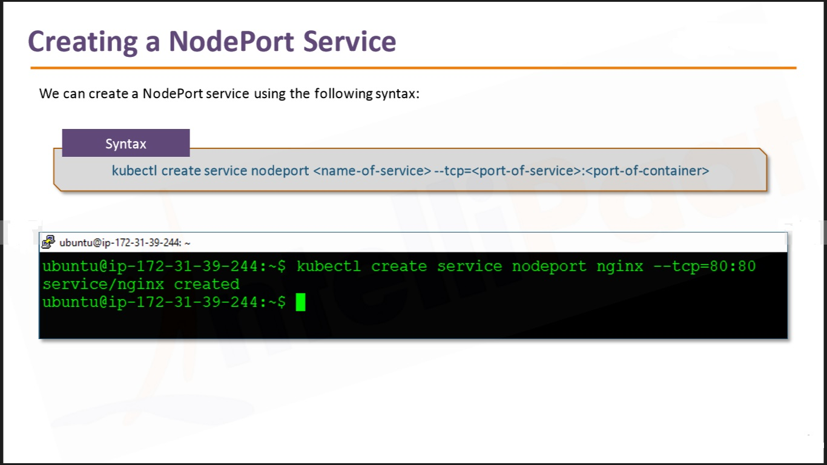

Slide 5
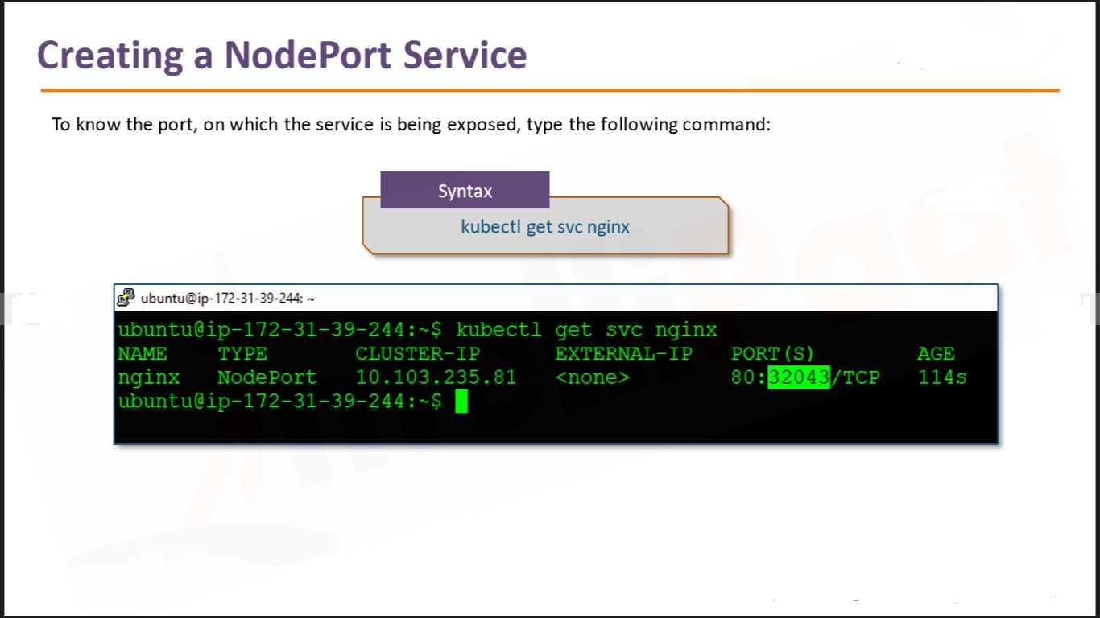

Slide 6
Steps for Master
Step 1: We will create a nodeport service for our nginx deployment, run the following command:
kubectl create service nodeport nginx --tcp=80:80
docker run --image mynginx -p 80:80 -d nginx
docker run -d –restart=always -e DOMAIN=cluster –name nginx-app -p 80:80 nginx”

Slide 7
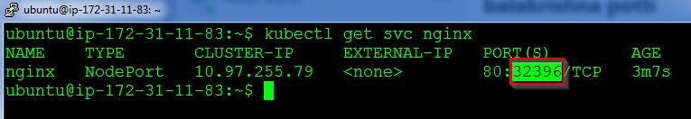
Step 2: Note down the Nodeport for this service by running the following command:
kubectl get svc nginx

Slide 8
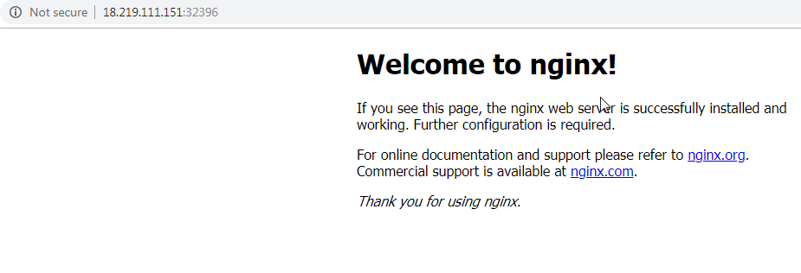
Step 3: Verify the working of the service by browsing to the IP address of the master or slave with this port

